Slide 1

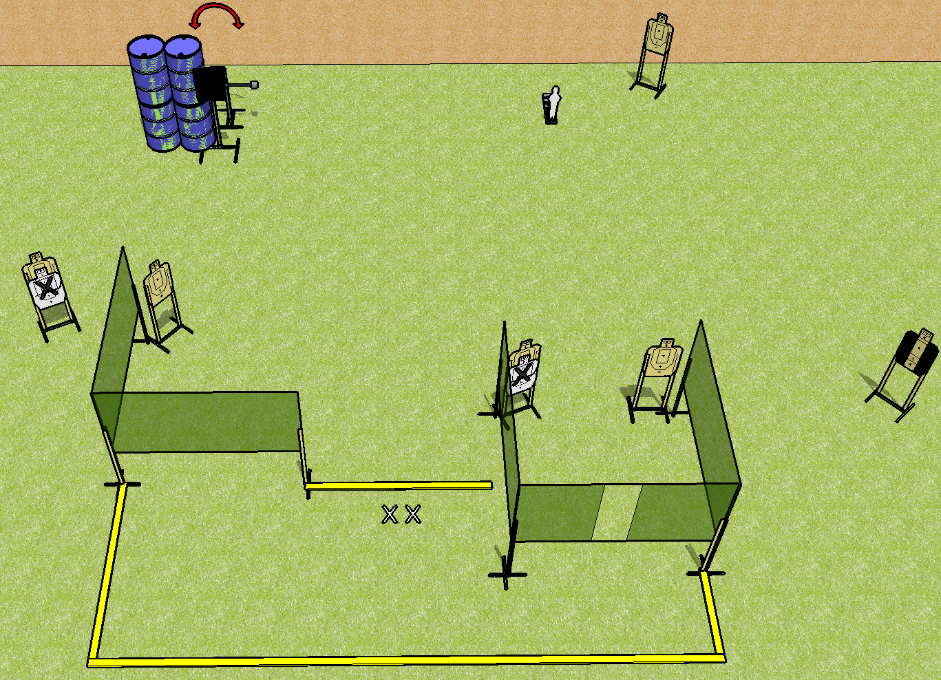
 | Dothan Practical Shooters – USPSA Match Ain’t No Thing Course Designer : Drew Coleman Bay: A1
Round Count 15 rounds 7 USPSA, 1 mini popper
Equipment List 7 wall feet Swinger + activator 8 targets (6 + 2NS), 1 tuxedo

Slide 2
Ain’t No Thing
Written Stage Briefing
Scoring: Comstock Rounds: 15
Targets: 7 USPSA, 1 steel
Handgun start position: feet on X’s, wrists below belt. Handgun is loaded and holstered.
PCC start position: feet on X’s, stock on belt. Loaded carbine is held with both hands, safety on.
Stage Procedure: on the audible start signal, engage targets as they become available from within the shooting area. T1 is activated by P1 and remains visible at rest.

